Slide 1
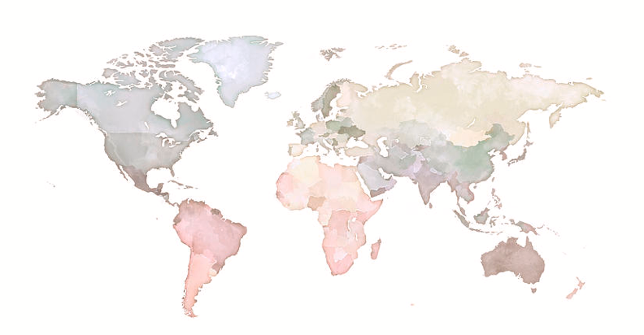
Airbnb new user bookings
Rebecca riso | metis project 3

Slide 2
Introduction
Motivation
Targeted advertising to potential international travelers: lifetime customers!
Objective
Predict first-user location
→ Domestic vs. international
Tools
Data wrangling: Pandas/numpy/SQL
Data visualization: Seaborn/flask/bokeh
Modeling: Sklearn

Slide 3
Data infrastructure
USER DATA
user id
country destination
COUNTRY DEMOGRAPHICS
country destination
COUNTRIES
country destination
SESSIONS
user id
session id
FEATURE ENGINEERING

Slide 4
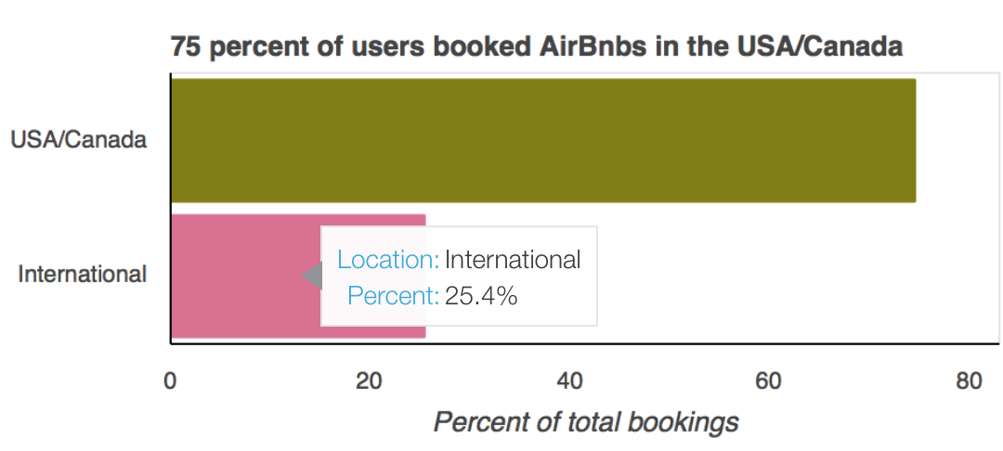
Data: Target
Stratified sampling | Oversampling training set

Slide 5
Methodology
F-β scoring (β=2) |Gridsearch CV | 3 fold cross validation
Model | Parameters | F2 score
Random forest | Max depth = 6; Max features: auto; Number of estimators: 500; Criterion: Entropy | 0.58
SVM (RBF) | C: 10; Gamma: 0.001 | 0.55
Logistic regression | C: 0.01; Regularization penalty: L1 | 0.51
Decision tree | Max depth = 7 | 0.48
KNN | Number of neighbors: 1 | 0.26

Slide 6
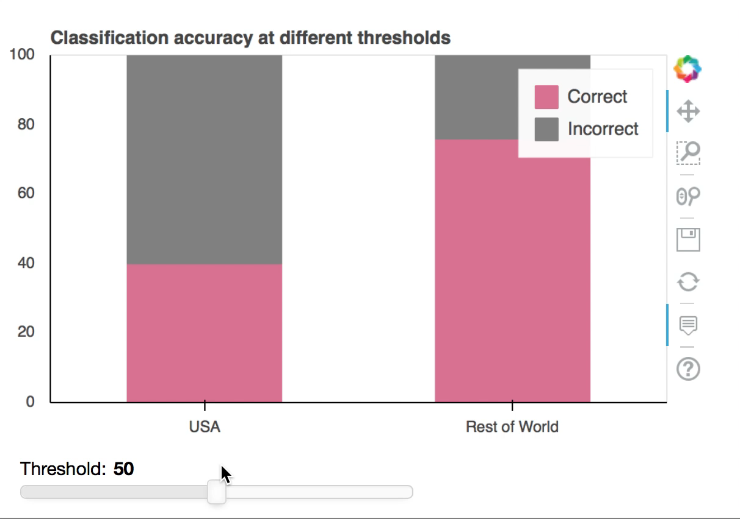
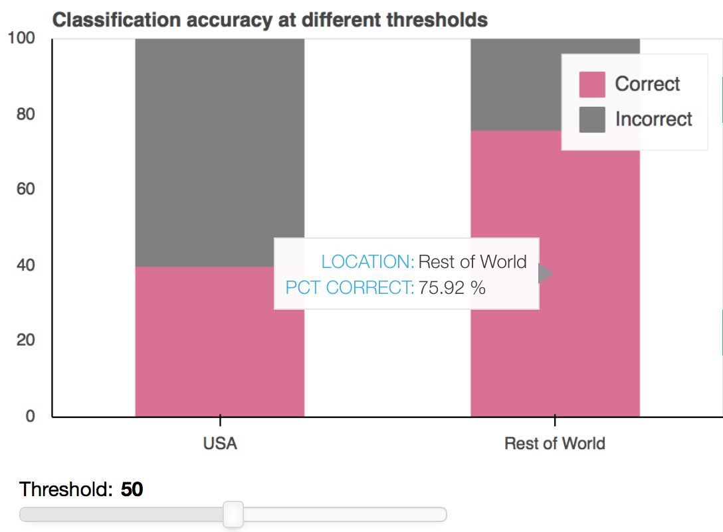
Model refinement

Slide 7
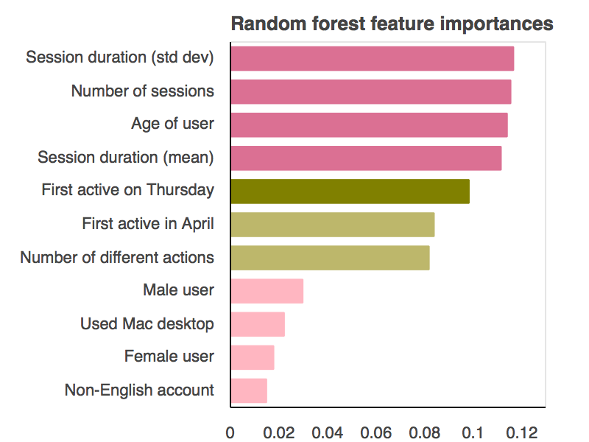
Model results

Slide 8
Conclusions/Future work
Important features
Language
Research (session time/ desktop)
Day and month of signup
Additional features
ID place of issue
More recent data
Multi-class prediction
Where outside of the US?

Slide 9
Questions?

Slide 10
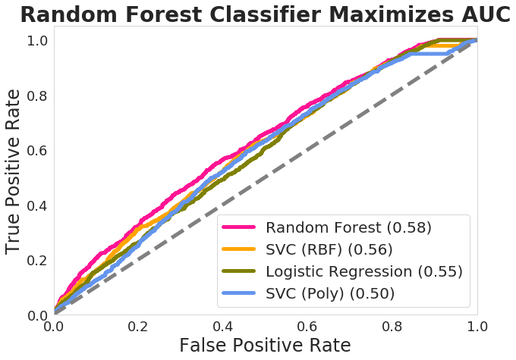
Appendix A

Slide 11
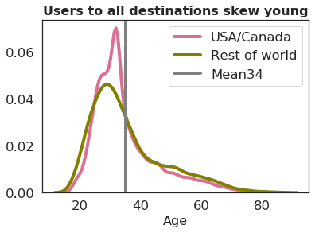
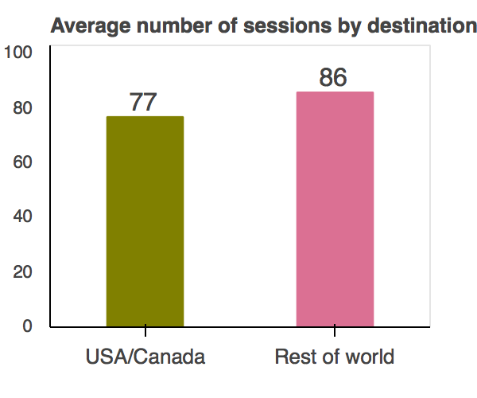
Appendix B

Slide 12
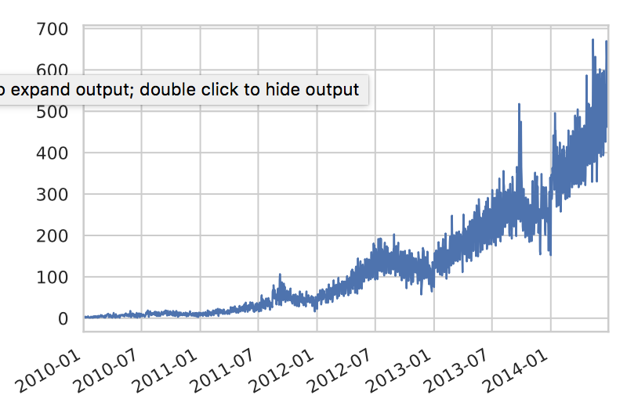
Appendix C
Increasing popularity of Airbnb over time
Accounts created

Slide 13
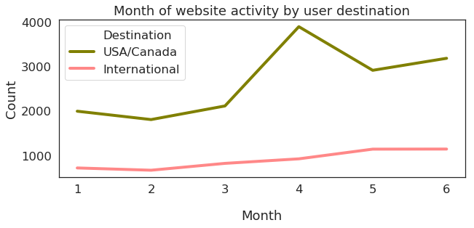
Appendix D
Jan Feb Mar Apr May Jun

Slide 14
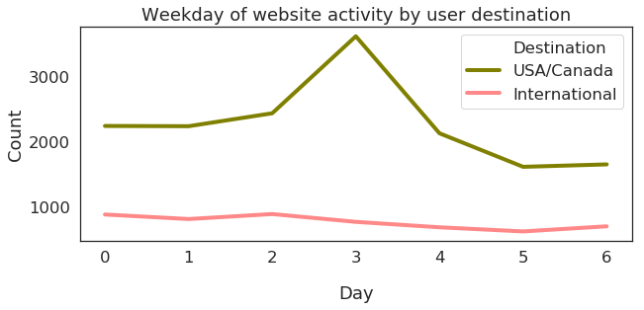
Appendix E
Mon Tues Wed Thurs Fri Sat Sun

